Slide 1
Chapter 20
Conclusion
Summary and Thank you

Slide 2
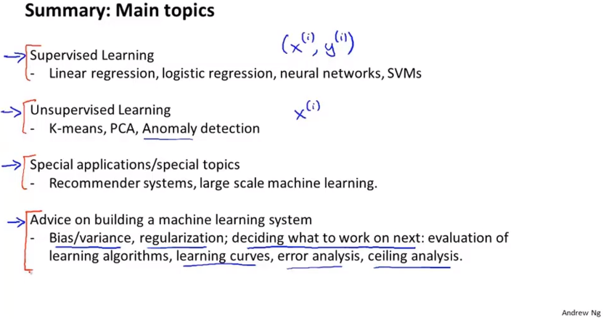
Chapter 20
Evaluation metrics like precision recall, F1 score as well as practical aspects of evaluation like training, cross-validation and test-sets.

